Slide 1
Agile Development Test-Driven Development and Code Refactoring
Tomáš Vomáčka
April 30, 2024
Notes:
Choose between slides 1 through 6 for your presentation’s title slide, depending on the industry focus.

Slide 2
O mně
ZČU
2006: Informatika
2008: Počítačová grafika a výpočetní systémy
2020: Informatika
Iconics
2012 – 2023: Software Development Engineer
2023: Team Leader
Kontakt
https://www.linkedin.com/in/tvomacka/
https://github.com/tvomacka
tomasv@iconics.com

Slide 3
Agilní Vývoj
Iterativní proces vývoje
Jednotlivci a interakce před procesy a nástroji Fungující software před vyčerpávající dokumentací Spolupráce se zákazníkem před vyjednáváním o smlouvě Reagování na změny před dodržováním plánu

Slide 4
Test-Driven Development

Slide 5
Code Refactoring

Slide 6
Zdroje
Agile Manifesto
https://agilemanifesto.org/iso/cs/manifesto.html
Llewelyn Falco
https://github.com/isidore
Arlo’s Commit Notation
https://github.com/RefactoringCombos/ArlosCommitNotation
ReSharper
https://www.jetbrains.com/resharper/

Slide 7
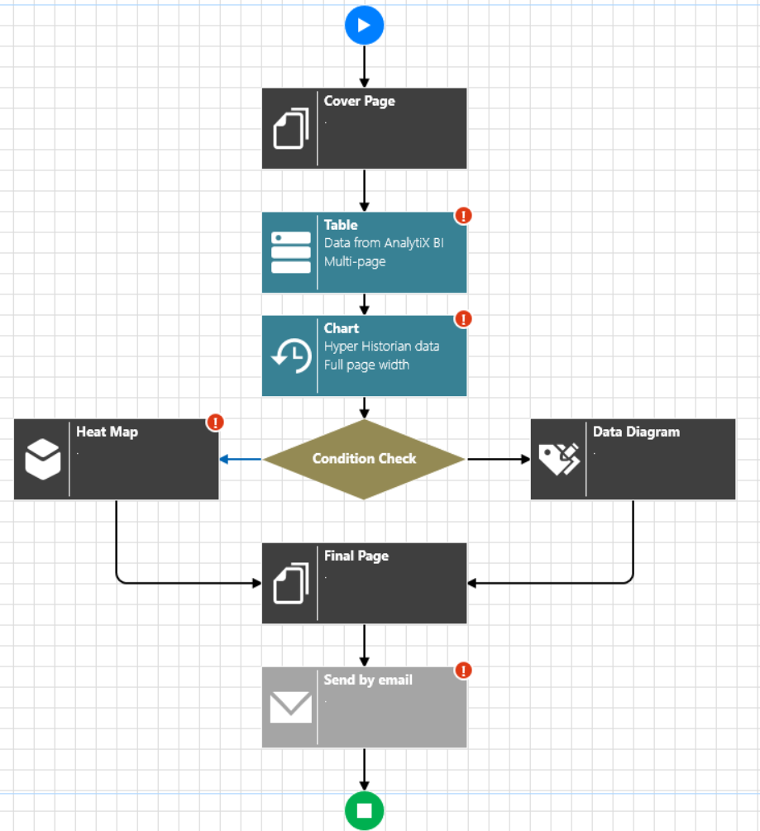
Template Definition
How to define templates without Excel?
An option could be to use a workflow editor like BridgeWorX
Report creation would follow the flow as in a transaction
Each “block” could be for one type of content

Slide 8
Other Topics To Consider
Custom Parts
Same way you can create Custom Blocks, you could do Custom Parts
Parameters/Dynamic Parameters/Dependent Parameters
Must be possible to specify these
Global Aliases could be used as parameters inside content
Allow usage of BridgeWorX Blocks
Might provide value to further process data during report execution
Totally new Parts
A “spreadsheet” part could be useful (similar to MEAG)
Cascading Content
Next Part might depend on Previous (i.e. tabular data to feed a chart)
Advanced layouting
Different header/footer for different pages, page breaks, … (see Word basically)

Slide 9





Thank You!
Learn more at
iconics.com or email info@iconics.com
Stay up to date with ICONICS

Slide 10
How to edit Team & Agenda Slides
This is SmartArt. A popup will display on the left when you try edit it. To add more Team Members or Agenda items, hit the “Enter” key on the last entry.
Click the picture icon to browse for a photo of the corresponding team member.

Slide 11
Meet the Presentation Team
[Text]
Notes:
This is a backup copy in case you mistakenly delete the Team slide from the main presentation.

Slide 12
Agenda
[Text]
[Text]
Notes:
This is a backup copy in case you mistakenly delete the Agenda slide from the main presentation.

Slide 13
Icons
If you don’t see what you’re looking for, check the Marketing Portal or send specific requests to brett@iconics.com.

Slide 14
































Product Logos
Don’t see what you need? Check the complete list of logos here: https://iconics.sharepoint.com/:f:/r/sites/MarketingPortal/Graphics/_ICONICS%20logos?csf=1&web=1&e=7uW9G9
© ICONICS Inc., 2021

